Slide 1



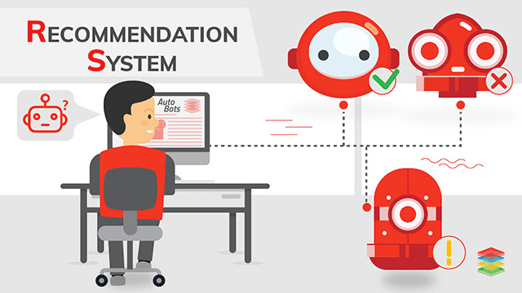
PRODUCT
RECOMMENDATION
SYSTEM

Slide 2
PROJECT MENTOR &TEAM
Project Mentor
Dilavar Basha
Project Members
  Shraddha Lokande
  Yash Sonone
  Jayshri Kor
  Supriya Mathpati
  Prasanna Kulkarni
  Hemasai Reddy
  Sathwik Putta

Slide 3
OBJECTIVE
  To build a product recommendation system.
  To analyze user-product interaction data to understand user preferences.
  To recommend similar products based on rating behavior.
  To deploy the recommendation system as a web-based application

Slide 4
PROBLEM STATEMENT
  E-commerce platforms offer a large number of products, making it difficult for users to identify items that match their preferences.
  Manual searching through vast product catalogs leads to information overload and poor user experience.
  There is a need for an automated product recommendation system that can analyze past user behavior and suggest relevant and similar products.

Slide 5
DATASET DETAILS
The dataset contains user-product rating interactions.
1.Dataset Size:
  Number of records: 78246
  Number of attributes: 4
2. Attributes
  userId: Unique user identifier
  productId: Unique product identifier
  rating: Rating given by the user
  timestamp: Time of rating
3.Dataset Usage
  Used to analyze user preferences.
  Supports item–item collaborative filtering for product recommendations.

Slide 6
EXPLORATORY DATA ANALYSIS
Introduction & Data Overview:
  Exploratory Data Analysis (EDA) is performed to understand the structure and characteristics of the dataset.
  It helps identify patterns, trends, and relationships in user-product rating data.
  EDA provides insights that support the selection of a suitable recommendation approach.
  There are 76,430 Unique Users, 40,228 Unique Products and 78,245 Total Interactions.

Slide 7
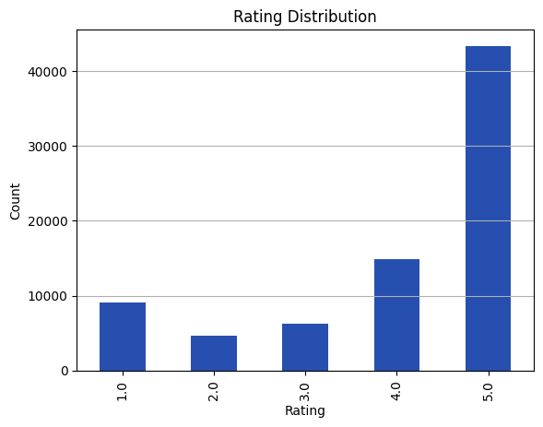
Distribution of Product Ratings:
  The chart shows the distribution of ratings provided by users across products.
  Most ratings are concentrated around specific values, indicating common user preferences.
  This distribution helps understand overall user satisfaction and rating behavior.

Slide 8
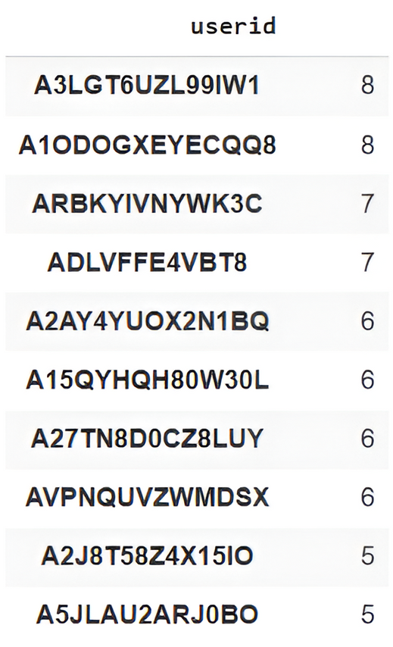
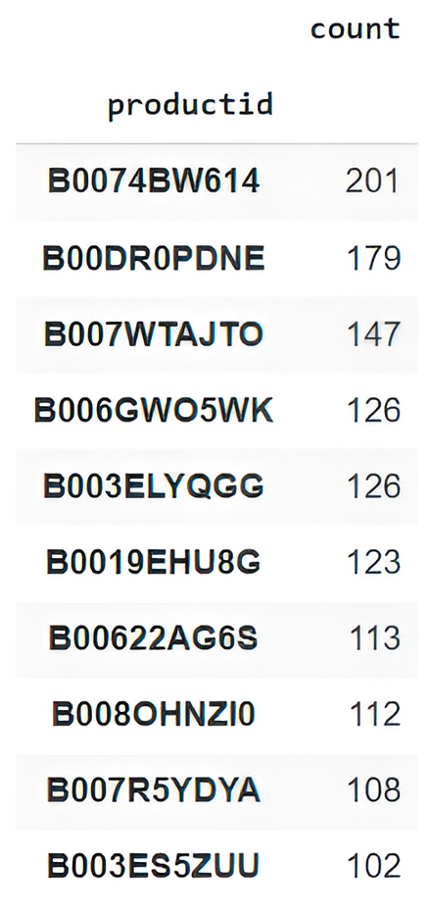
Most Active Users:
Most Rated Products:
The list shows users with the highest number of ratings in the dataset.
The list displays products that have received the highest number of ratings.

Slide 9
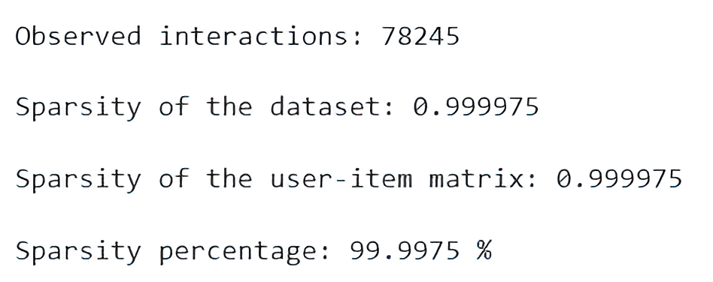
Data Sparsity:
  The user-product interaction matrix is highly sparse.
  Most users have rated only a small fraction of available products.
  Sparsity is a common challenge in recommendation systems and affects model performance.

Slide 10
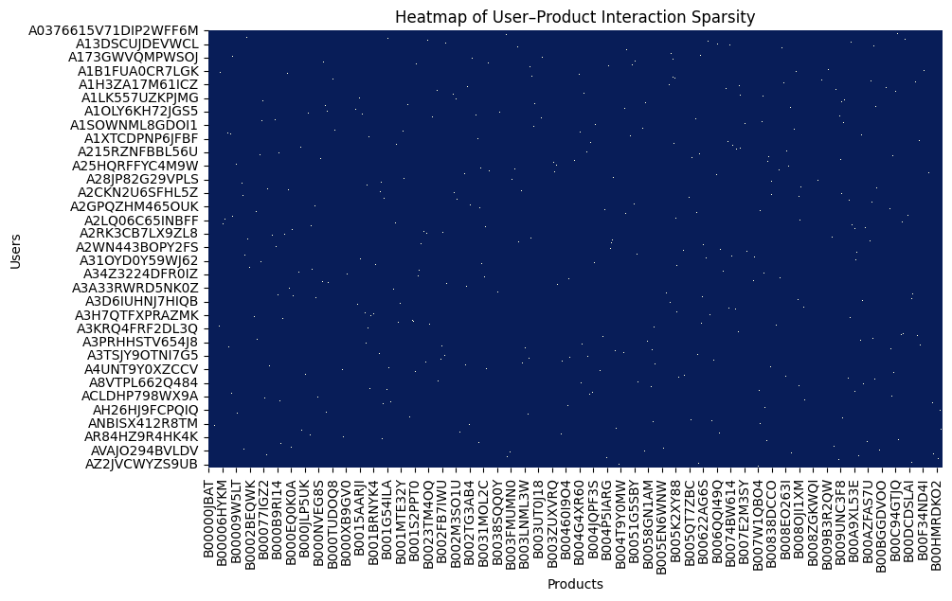
User-Product Interaction Heatmap:
  The heatmap shows rating interactions between users and products.
  Most cells are empty, confirming high data sparsity.
  Only a limited number of user–product pairs have ratings.

Slide 11
Data Filtering:
  Data filtering was applied to remove users and products with very few interactions.
  The Original dataset before data filtering is (78245, 3)
  After doing the data filtering the dataset size is (1020, 3)
  This helps reduce noise and improves the reliability of similarity calculations.
  Filtering ensures that the recommendation system is trained on meaningful user-product interactions.
  Low-interaction users/products add little value to recommendations.
  Filtering improves both accuracy and performance.

Slide 12
User-Item Matrix Creation:
  A user-item matrix was created using users as rows and products as columns.
  There were 824 users and 743 products.
  Each cell represents the rating given by a user to a product.
  Most entries in the matrix are 0, showing that users interact with only a few products.
  This confirms that the data remains highly sparse, even after filtering.
  This matrix forms the foundation for similarity calculation and recommendation generation.
  Most matrix values are empty, reinforcing data sparsity.
  Structured representation enables efficient computation.

Slide 13
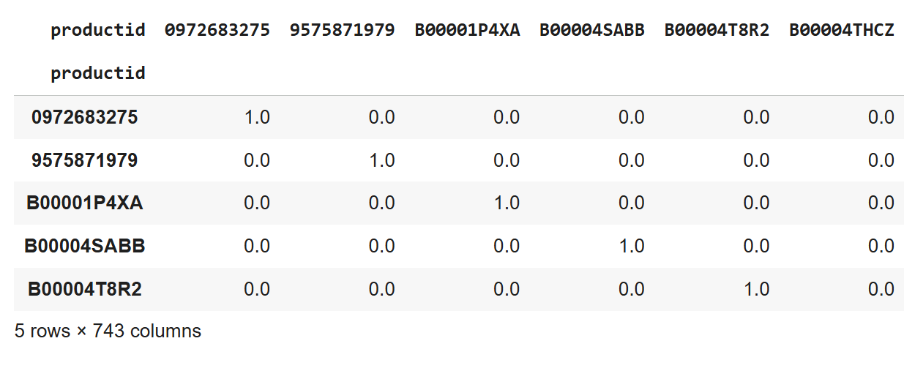
MODEL BUILDING
1. Model 1 – Item-Based Collaborative Filtering:

Slide 14
  Item-based collaborative filtering recommends products similar to those previously rated by the user.
  Similarity between products is calculated using user rating patterns.
  Works well for sparse datasets with many users and items.
  Provides stable and scalable recommendations for e-commerce platforms.
  Focuses on product-to-product relationships, which helps generate personalized suggestions efficiently.
  Reduces cold-start impact for frequently rated items, improving user experience.

Slide 15
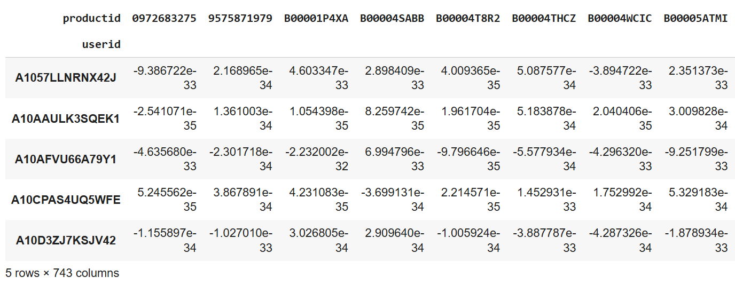
2.Model 2 – SVD Matrix Factorization:

Slide 16
  SVD (Singular Value Decomposition) decomposes the user–item matrix into latent features representing users and products.
  Helps capture hidden patterns in user preferences and item characteristics.
  Works well for sparse datasets, improving prediction accuracy.
  Reduces dimensionality, making computations faster and more scalable.
  Can predict missing ratings by reconstructing the approximated user–item matrix.
  Enhances recommendation quality by identifying subtle similarities not visible in direct user-item interactions.

Slide 17
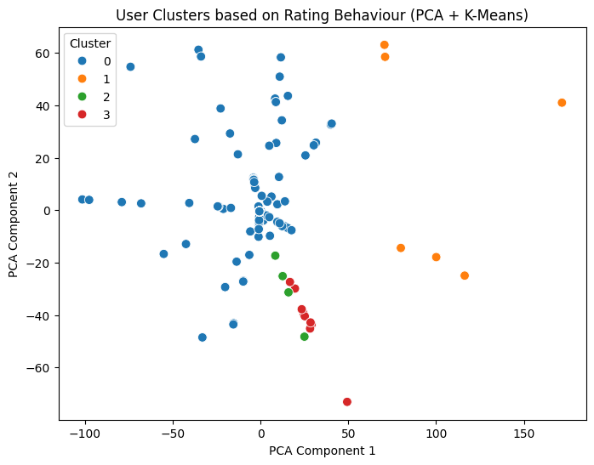
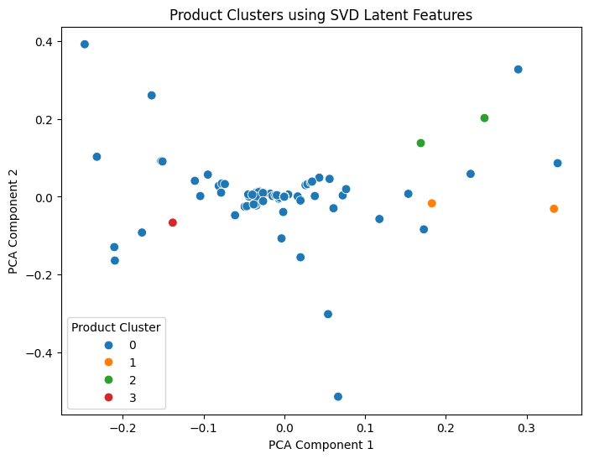
3.Model 3 - K-Means Clustering (User & Product Segmentation)
User-based Clustering (Based on Rating Behaviour)
Product-based Clustering (SVD latent features)
  Cluster 0 represents the largest group of users with common rating patterns.
  Clusters 1, 2, and 3 represent smaller user groups with distinct or niche preferences.

Slide 18
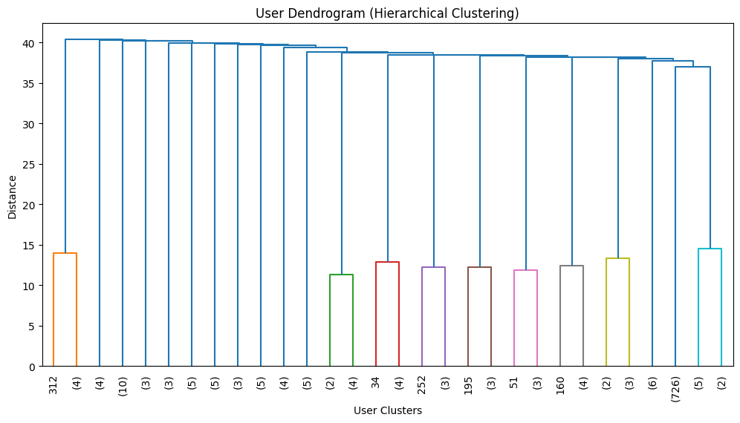
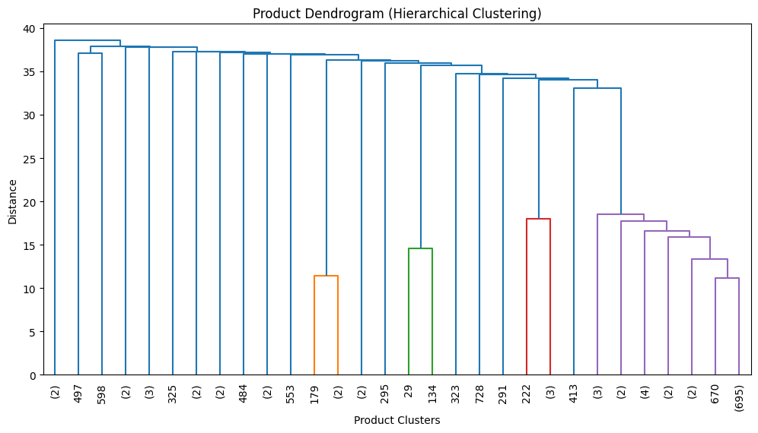
User Dendrogram
Product Dendrogram
  Cluster 0 represents majority users with balanced rating behaviour.
  Cluster 1 contains users with consistent and selective preferences.
  Cluster 2 includes exploratory users with diverse rating patterns.
  Cluster 3 represents outlier users with unusual or extreme behaviour.

Slide 19
  K-Means clustering was used to group users and products based on similar rating patterns.
  Users with similar preferences are placed into the same cluster.
  Products with similar engagement behavior are grouped together.
  Clustering helps identify behavioral segments within the dataset.
  These segments can be used to improve recommendation relevance.
  K-Means provides an efficient and scalable approach for large datasets.
  User-based clustering achieved a silhouette score of 0.8477.
  This indicates strong cohesion within user clusters and good separation between them.
  Product-based clustering achieved a silhouette score of 0.9064.
  The high product silhouette score confirms meaningful grouping in the latent feature space.

Slide 20
Final Model - SVD (Singular Value Decomposition):
  Multiple recommendation models were implemented and evaluated.
  Item-Based Collaborative Filtering served as a baseline model.
  K-Means clustering was used for user and product segmentation.
  SVD demonstrated superior performance in ranking-based evaluation.
  Achieved higher Precision@K and Hit@K values.
  Effectively captured latent user - item relationships.
  Provided consistent and relevant recommendations.
  Selected as the final model for deployment.

Slide 21
Model Evaluation:
  The final SVD model was evaluated using ranking-based metrics
  Precision@K measured the accuracy of top-K recommendations
  Precision@10 assessed the relevance of the top 10 suggested products
  Hit@K verified the presence of relevant items in the recommendation list
  The SVD model demonstrated strong and consistent evaluation performance

Slide 22
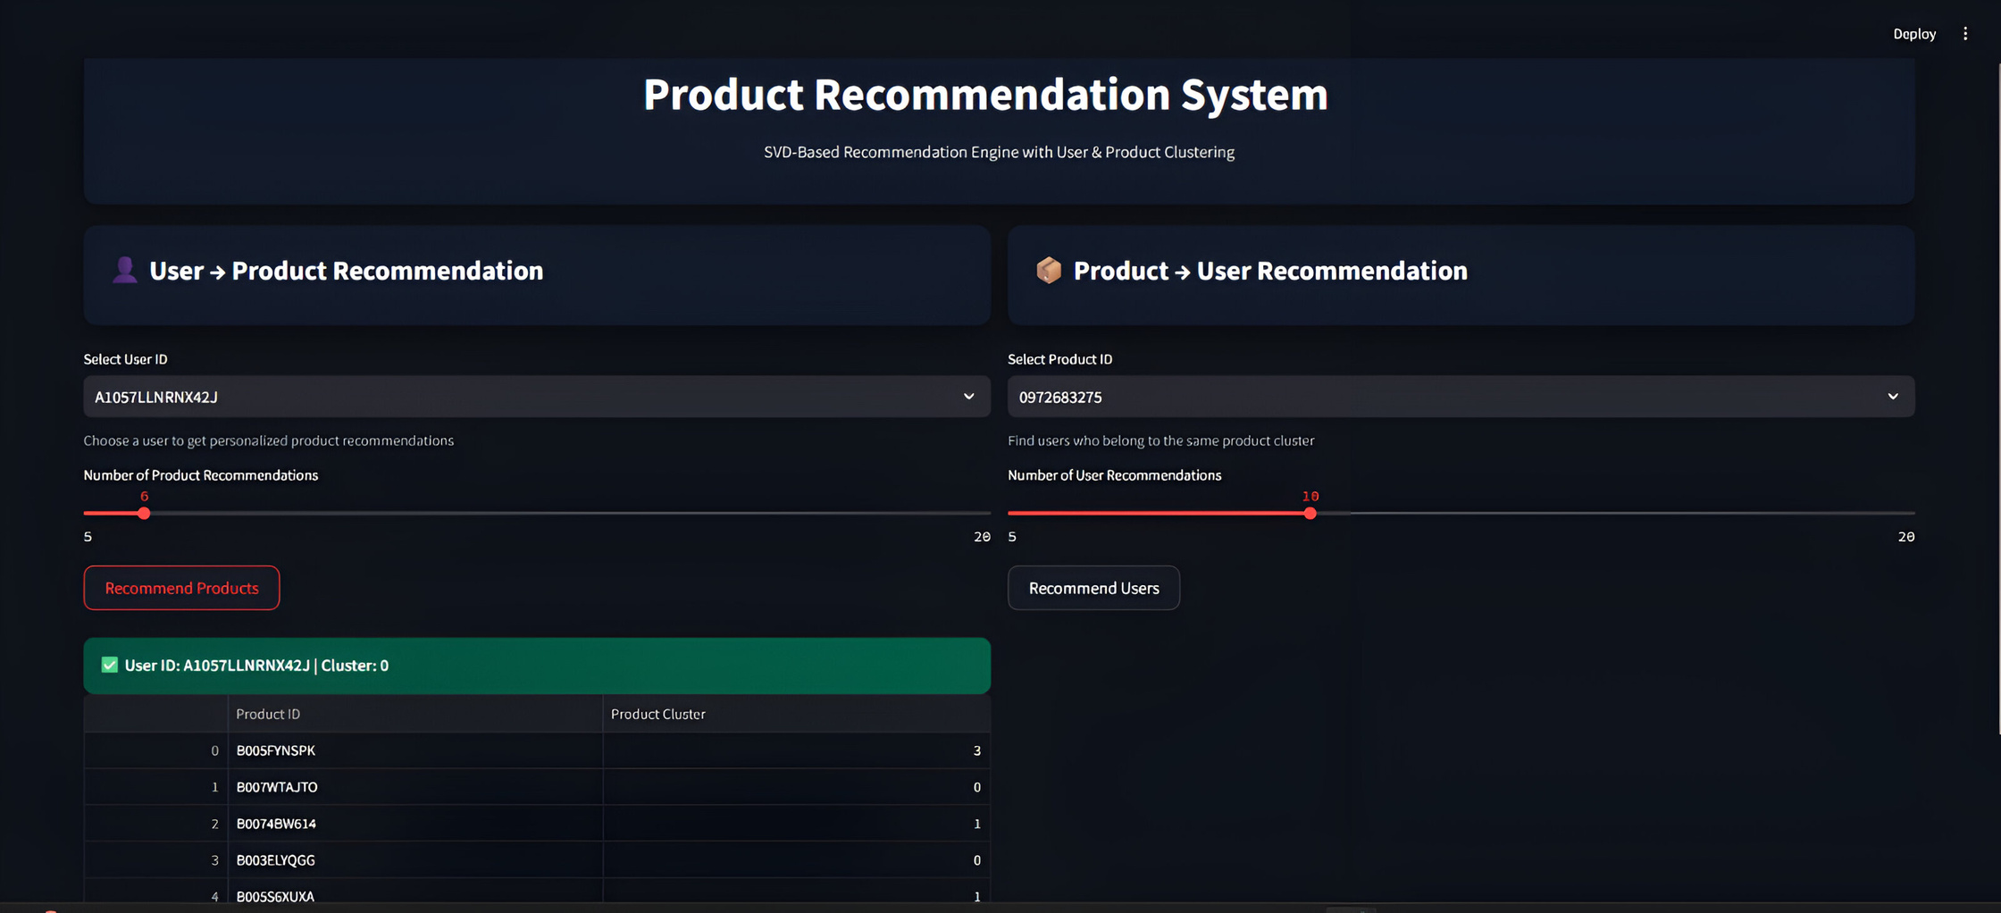
DEPLOYMENT

Slide 23
  Deployed the final recommendation system as an interactive web application.
  Supports User → Product recommendations using SVD-based collaborative filtering.
  Allows users to select a User ID for personalized recommendations.
  Provides dynamic control over the number of recommendations using a slider.
  Supports Product → User recommendations using clustering-based segmentation.
  Displays recommendations instantly through a user-friendly interface.

Slide 24
Challenges Faced During the Project:
  Most users rated only a few products, making it difficult to generate accurate recommendations for new users or items.
  Choosing the best model among Item-Based CF, SVD, and K-Means required extensive testing and careful metric-based evaluation.
  Integrating the recommendation model into a web application for real-time predictions posed significant technical and optimization challenges.

Slide 25
Conclusion:
  Developed a complete recommendation system from data preprocessing to deployment.
  Implemented Item-Based CF, SVD Matrix Factorization, and K-Means Clustering to generate accurate and personalized recommendations.
  Ensured recommendation relevance using Precision@K, Precision@10, and Hit@K metrics.
  Successfully deployed the system as a web application, enabling real-time personalized product suggestions for users.

Slide 26
THANK
YOU.....

